Slide 1
Testing Strategies and Methodologies
Prepared by Chala Urgessa
C 2.1

Slide 2
Objective
The objective of this presentation is to show the
How to define Software Testing Principles
What are the types of Software Tests
What is Test Planning
Test Execution and Reporting
Real-Time Testing
C 2.1

Slide 3
Basics of Software Testing (软件测试基础) (Recap)
Testing(测试)
Running a program to find mistakes.
  Purpose: To make sure the program can do what it's supposed to do.
Verification(验证)
Checking if we are making the program the right way.
  Purpose: to confirm we're following the plan correctly.
C 2.1

Slide 4
Basics of Software Testing (软件测试基础) (Recap)
Validation(确认)
Making sure the program does what the user needs in real life.
  To check the program meets user needs.
Debugging(调试)
Finding and fixing mistakes in the program.
  To correct any problems so the program works smoothly.
C 2.1

Slide 5
Class Activity
Question 1: What is the primary goal of testing a program?
A) To change the program's functionalities.
B) To find and add new features.
C) To find mistakes in the program.
D) To redesign the user interface.
Question 2: What does verification aim to achieve in software testing?
A) Ensuring the program is free of any user interface issues.
B) Checking if the development process is aligned with the specifications.
C) Adding new functionalities as per user feedback.
D) Making the software more appealing.
Question 3: What is the purpose of validation in software development? (
A) To ensure the program is developed quickly.
B) To make sure the program meets real-life user needs.
C) To check the color scheme of the program.
D) To increase the program's loading speed.
Question 4: What does debugging involve?
A) Changing the program's core functionality.
B) Testing the program on different operating systems.
C) Redesigning the program's architecture.
D) Finding and fixing mistakes in the program.
C 2.1

Slide 6
Essential Principle of Software Testing (软件测试的基本原则)
Focus on Early Defect Removal (专注于早期缺陷移除)
Main Insight: Aim to identify and fix problems before testing. (在测试之前识别并修复问题。)
Why Important: Testing can uncover defects, but it's more efficient to prevent them. (测试可以发现缺陷，但预防缺陷更有效。)
Testing's Role:
  Limited Improvement: Testing is crucial but has its limits in enhancing quality. (测试至关重要，但在提高质量方面有其局限性。)
  Cost-Effectiveness: Early fixes are less costly and save resources. (早期修复成本较低，可节省资源。)
C 2.1

Slide 7
Cont...
Strategies for Early Defect Removal:
Code Reviews: Regularly check code for errors. (定期检查代码错误。)
Automated Tools: Utilize software tools for early detection. (使用软件工具进行早期检测。)
Thorough Planning: Prevent issues with good project planning. (通过良好的项目计划预防问题。)
Key Takeaway: Focus on quality from the start to make testing more effective and efficient. (从一开始就关注质量，使测试更有效、更高效。)
C 2.1

Slide 8
Types of Software Testing (软件测试类型)
Unit Testing (单元测试): White Box Testing
  Tests individual parts of code.
Integration Testing (集成测试)
  Tests combined functionality of units.
Function Testing (功能测试): Black Box
  Tests application functions without internal code.
System Testing (系统测试)
  Tests the complete, integrated application.
Smoke and Sanity Testing (冒烟和理智测试)
  Quick tests for basic functionality and after minor changes.
Regression Testing (回归测试)
  Ensures updates don't break existing features.
Acceptance and Installation Tests (验收和安装测试)
  Checks system against user requirements and correct installation.
Non-functional Testing (非功能测试)
  Tests aspects like performance, load, and stress.
C 2.1

Slide 9
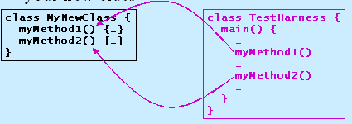
Unit Testing (单元测试) (White Box)
A unit is the smallest testable part of software
In procedural programming a unit may be an individual program, function, procedure, etc. In OOP, the smallest unit is a method.
Unit testing is often neglected but it is, in fact, the most importnat level of testing.
C 2.1

Slide 10
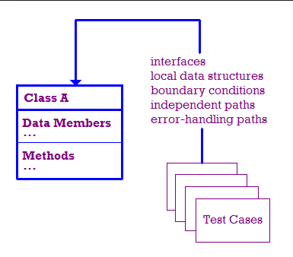
Unit Testing Methodology
(单元测试方法)
How It's Done (执行方式):
  unit Testing is performed by using the method White Box Testing
When is it performed (执行时间):
  Unit Testing is the first level of testing and is performed prior to Integration Testing
Who performs it (谁来执行)?
  Unit Testing is normally performed by software developers themselves or their peers. In rare cases it may also be performed by independent software testers.
C 2.1

Slide 11
Class Activity
Question 1: What is Unit Testing?
A) Testing the entire software system.
B) Testing the software only after it is fully developed.
C) Testing the smallest testable parts of the software.
Question 2: When is Unit Testing performed?
A) Before Integration Testing.
B) After the software is fully developed.
C) Only after releasing the software.
Question 3: Who normally performs Unit Testing?
A) End-users of the software.
B) Software developers or their peers.
C) Only independent software testers.
C 2.1

Slide 12
Integration Testing
Integration Testing is where individual parts (units) of software are combined and tested together. (集成测试是将软件的各个部分（单元）组合在一起并进行测试的过程。)
  Integrated testing test inteface between componenets, interaction to different parts of system.
ANALOGY
  During the process of manufacturing a ballpoint pen, the cap, the body, the tail and clip, the ink cartidge and the ballpoint are produced separately and unit tested separately and integration testing is performed. For example, whether the cap fits into body or not.
METHOD
  an use Black Box, White Box, or Grey Box Testing methods. (可以使用黑盒测试、白盒测试或灰盒测试方法。)
  The choice of method often depends on how a 'unit' is defined in your project. (方法的选择通常取决于项目中如何定义“单元”。)
C 2.1

Slide 13
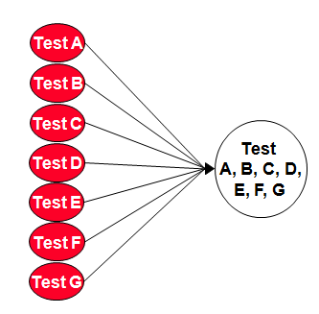
Integration Testing Approaches (集成测试方法)
Big Bang Test (大爆炸测试) - All or most units are combined and tested in one go. (将所有或大部分单元合并在一次测试中。)
When to Use: This method is used when the testing team receives the entire software bundle at once. (当测试团队一次性收到整个软件包时使用。)
  Characteristics:
    Simplifies coordination (简化协调工作)
    Risk of identifying issues late (较晚识别问题的风险)
C 2.1

Slide 14
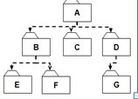
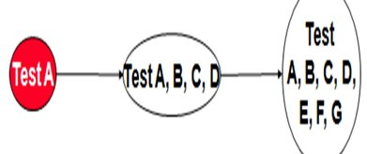

Integration Testing Approaches (集成测试方法)
Top-down Integration Test - A testing strategy where testing begins with the highest-level modules and progresses towards the lower-level modules, integrating and testing step by step. (一种测试策略，从最高级别模块开始测试，并逐步向下至较低级别模块进行集成和测试。)
C 2.1

Slide 15
Top-down Integration Test
Process (过程):
  1. Start at the Top: Begin with top-level modules, which are typically the ones providing the user interface and primary control flows. (从顶层模块开始，这些模块通常提供用户界面和主要控制流。)
  2. Integrate Downwards: Gradually integrate and test lower-level modules that provide supporting functionalities. (逐渐集成并测试提供支持功能的较低级别模块。)
  3. Use of Stubs: Temporary implementations (stubs) are used to simulate lower-level modules until they are actually developed and ready for testing. (使用临时实现（桩）来模拟较低级别的模块，直到它们实际开发并准备好进行测试。)
C 2.1

Slide 16
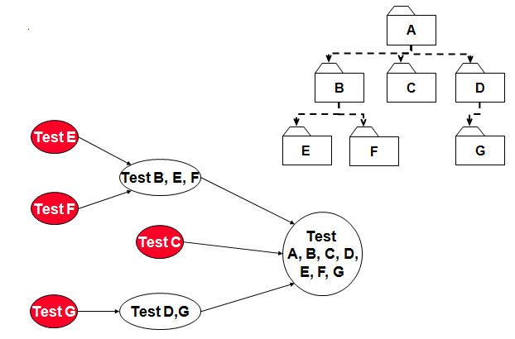
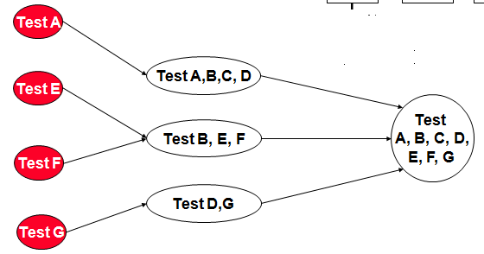
Integration Testing Approaches
Bottom-up Integration Test - A testing strategy that starts with the lowest-level modules and progresses upwards towards the higher-level modules, testing and integrating each level step by step. (一种测试策略，从最低级别的模块开始，逐步向上到更高级别的模块进行测试和集成。)
Sandwich / Hybrid A mixed approach that uses both Top-Down and Bottom-Up methods. (一种混合方法，同时使用自顶向下和自底向上的方法。).
  start Both Ways (双向开始) & Meet in the Middle (中间相遇)
C 2.1

Slide 17
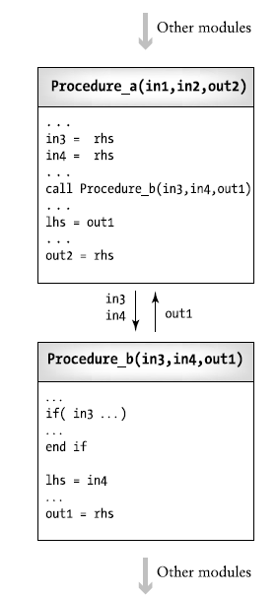
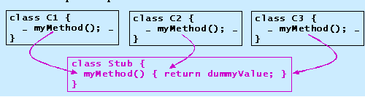
C 2.1

Slide 18
Class Activity
Question 4: Which of the following best describes the Sandwich (Hybrid) Integration Testing approach?
A) It combines the Big Bang approach with Regression Testing.
B) It is a combination of Top-Down and Bottom-Up approaches.
C) It focuses solely on performance testing of the software.
Question 5: Why might a project team choose the Sandwich (Hybrid) Integration Testing approach?
A) It requires less planning and fewer resources.
B) It is suitable for simple and small projects.
C) It offers a balanced testing strategy for complex projects with multiple teams.
Question 1: What does Integration Testing focus on?
A) Testing individual units separately
B) Testing the user interface only
C) Testing how different units work together
Question 2: What is the Big Bang Integration Testing approach?
A) Testing starts from the lowest level units upwards.
B) All units are combined and tested at once.
C) Testing is performed in random order.
Question 3: In Top-Down Integration Testing, testing starts with...
A) The lowest level modules.
B) The highest level modules.
C) Randomly selected modules.
C 2.1

Slide 19
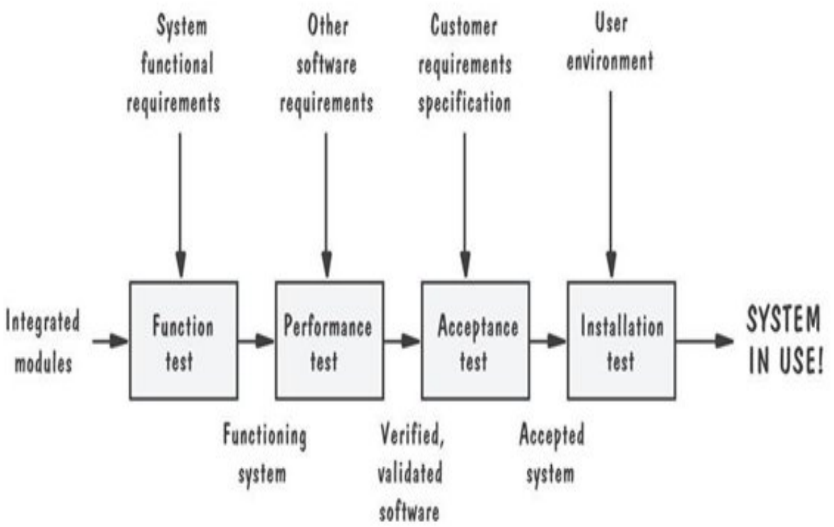
System Testing
C 2.1

Slide 20
System Testing
Functional Testing (功能测试)
  Goal (目标): Test the functionality of the system. (测试系统的功能。)
  Test cases are designed based on the requirements analysis document or user manual. (测试案例基于需求分析文档或用户手册设计。)
  Focuses on requirements and key functions (use cases).
  The system is treated as a black box. (专注于需求和关键功能（用例）。系统被视为黑盒。)
  Unit test cases can be reused; however, new test cases are also developed. (可以重用单元测试案例；但也需开发新的测试案例。)
Performance Testing (性能测试)
  Goal (目标): Test system performance under stress. (测试系统在压力下的性能。)
  Test how the system behaves when overloaded. (测试系统在过载时的表现。)
  Try unusual orders of execution and check the system’s response to large volumes of data. (尝试不寻常的执行顺序并检查系统对大量数据的响应。)
  Analyze the amount of time spent on different use cases. (分析不同用例所花费的时间。)

Slide 21
Class Activity
Question 1: Which testing method is used in Unit Testing?
A) White Box Testing
B) Black Box Testing
C) Grey Box Testing
Question 2: Why might new test cases need to be developed for Functional Testing in System Testing?
A) Because unit test cases are always irrelevant in system testing.
B) To ensure comprehensive coverage based on system requirements and use cases.
C) Because it's a mandatory requirement in all software development methodologies.
Question 3: What is the primary goal of Functional Testing in System Testing?
A) To check the system's speed and efficiency.
B) To ensure the system can handle a large number of users.
C) To test the system's functionality against the specified requirements.
D) To measure the system's uptime and availability.
C 2.1

Slide 22
Class Activity
Question 4: In Functional Testing, how is the system viewed?
A) As a white box where the internal structure is known.
B) As a black box where the focus is on input and output.
C) As a grey box, a mix of both white and black box testing.
D) None of the above.
Question 5: Which of the following is a focus of Performance Testing?
A) Testing the color scheme of the user interface.
B) Checking how the system behaves under heavy load or stress.
C) Ensuring that the system functions correctly on all devices.
D) Verifying the correctness of the application's business logic.
Question 6: Performance Testing often includes:
A) Reusing all unit test cases without modifications.
B) Testing the application in only the development environment.
C) Trying unusual orders of execution and response to large volumes of data.
D) Focusing solely on the aesthetic aspects of the system.
C 2.1

Slide 23
Types of Performance Testing
Security testing
  Try to violate security requirements
Environmental test
  Test tolerances for heat, humidity, motion
Quality testing
  Test reliability, maintain- ability & availability
Recovery testing
  Test system’s response to presence of errors or loss of data
Human factors testing
  Test with end users
Stress Testing
  Stress limits of system
Volume testing
  Test what happens if large amounts of data are handled
Configuration testing
  Test the various software and hardware configurations
Compatibility test
  Test backward compatibility with existing systems
Timing testing
  Evaluate response times and time to perform a function
C 2.1

Slide 24
Regression Testing
(回归测试)
Test the effects of the newly introduced changes on all the previously integrated code. (确保新更改不会破坏之前正常工作的功能。)
Strategy: Keep a big list of tests (regression bucket) but pick just a few (subset) to run more often.
  The big list is tested only sometimes because it takes a lot of time. (策略：保留一大套测试（回归测试集），但更频繁地运行其中的一小部分（子集）。因为测试大列表需要很多时间，所以只偶尔测试。)
Challenge: Hard to choose which tests to run more often. (挑战：难以选择更频繁运行哪些测试。)
C 2.1

Slide 25
Class Quiz
Question 1: What's the main point of Regression Testing?
A) Make sure new changes don't break old stuff.
B) Just to check new stuff.
C) To do fewer tests.
D) To find new problems.
Question 2: What's a 'regression bucket'?
A) A tool for testing.
B) A few tests we run all the time.
C) All the tests we can run to check.
D) Taking tests out.
Question 3: Why pick some tests to run more often?
A) So we never repeat tests.
B) To test quickly, focusing on likely affected areas.
C) Because we have to.
D) It makes testing less reliable.
Question 4: When do we run all the tests in the bucket?
A) After small changes.
B) Before any change.
C) Only now and then, because it's a big job.
D) Never, just the small group.
Question 5: What's tough about Regression Testing?
A) Deciding on new features to test.
B) Choosing which tests to run more.
C) Getting enough people for testing.
D) Convincing others it's important.
C 2.1

Slide 26
Acceptance Testing
(验收测试)
A type of test to check if the software does what it's supposed to do for the business. (一种测试类型，用于检查软件是否满足业务需求。)
  How It Works: The whole application needs to be working to do this test. It tries to act like a real user to see if the software can handle real-life tasks. (如何工作：进行此测试需要运行整个应用程序。它尝试像真实用户一样行动，以查看软件是否可以处理现实生活中的任务。)
  What Else: It's not just about if it works; it can also check if the software is fast enough or meets other important goals. If not, changes might be rejected. (还包括什么：不仅仅是关于它是否工作；它还可以检查软件是否足够快或满足其他重要目标。如果不满足，可能会拒绝更改。)
C 2.1

Slide 27
Acceptance Testing
(验收测试)
Alpha Testing (Alpha 测试)
  The client tests the software at the maker's place. (是什么：客户在开发者的环境中测试软件。)
  Setting: It's a controlled environment, and the developer fixes bugs as they come up. (环境：在受控环境中进行，开发者随时准备修复漏洞。)
Beta Testing (Beta 测试)
  Testing done at the client's own place, without the developer being there. (是什么：在客户自己的环境中进行测试，开发者不在场。)
  Purpose: The software is used in real conditions to see how well it works. (目的：软件在实际条件下使用，以查看其工作性能如何。)
Goal: To show the system is ready to be used for real. (目标：证明系统准备好投入实际使用。)
Who Chooses Tests: The client picks the tests, often using some from earlier integration testing. (测试选择：客户选择测试，通常使用一些之前的集成测试。)
Who Performs It: Done by the client, not the software maker. (执行者：由客户进行，而非开发者。)
C 2.1

Slide 28
Class Activity
Question 1: What is the main goal of Acceptance Testing?
A) To fix all software bugs.
B) To demonstrate the system is ready for operational use.
C) To test the software only in a controlled environment.
D) To develop new features based on client feedback.
Question 2: Where is Alpha Testing conducted?
A) At the client's environment.
B) In a public setting.
C) At the developer's environment.
D) Online, without any direct supervision.
Question 3: What distinguishes Beta Testing from Alpha Testing?
A) Beta Testing is only for checking performance.
B) Beta Testing is conducted without the developer present, in the client's environment.
C) Beta Testing is not performed by real users.
D) Beta Testing focuses on fixing bugs, not on user experience.
C 2.1

Slide 29
Smoke Testing
(烟雾测试)
To quickly check the main parts of an app to see if they work right. (快速检查应用的主要部分是否正常工作。)
When It's Done:
  After a new version of the app is made (新版本制作后).
  After the app is put into a new place to run (部署到新环境后).
Why It's Useful (为什么有用):
  Fast: It doesn't take much time. (快速：不需要太多时间。)
  Early Checks: Helps decide if it's okay to do more detailed tests. (早期检查：帮助决定是否可以进行更详细的测试。)
  Deployment Check: Makes sure the app works in its new environment. (部署检查：确保应用在其新环境中正常运作。)
C 2.1

Slide 30
Class Activity
Question 1: What is the main goal of Smoke Testing?
A) To test every single detail of the application.
B) To replace all other types of testing.
C) To test the application's security features.
D) To ensure the major features of the system work as expected.
Question 2: When is Smoke Testing typically performed?
A) Only before the project starts.
B) Right after a new build or deployment.
C) Once a year.
D) After every user feedback.
Question 3: Why are Smoke Tests useful?
A) They prove that the application is 100% free of bugs.
B) They are the most detailed tests available.
C) They provide a quick check to validate major functionalities.
D) They are the only tests needed before deployment.
C 2.1

Slide 31
What is Test Planning
Define the functions, roles and methods for all test phases.
Test planning usually start during the requirements phase.
Major test plan elements are:
  Objectives for each test phase
  Schedules and responsibilities for each test activity
  Availability of tools, facilities and test libraries.
  Set the criteria for test completion
C 2.1

Slide 32
Test Execution & Reporting
Testing should be treated like an experiment.
Testing require that all anomalous behavior be noted and investigated.
Big companies keep a special library with all copies of test reports, incident forms, and test plans
C 2.1

Slide 33
Real-Time Testing
Real-Time testing is necessary because the deployment system is usually more complicate than development system
Rules apply for testing real time system
  Evaluate possible deadlocks, thrashing to special timing conditions
  Use tests to simulate hardware faults.
  Use hardware simulation to stress the software design.
  Design ways to simulate modules missing in the development system.
C 2.1

Slide 34
References
DeMillo, Software Testing and Evaluation Benjamin/Cummings Publishing Company, Inc California, 1987.
Sommerville, Software Engineering Addison-Wesley Publishing Company, 1996
Humphrey, Managing the Software Process, Addison-Wesley Publishing Company, 1990.
C 2.1

